Slide 1
HW6 Ch. 5.1-6 Solution
金緒勳
綜二R737
kim60138@gmail.com

Slide 2
Q1:
Please give an example to each of the following binary tree types.
Full binary tree
Complete binary tree
Skewed binary tree
Balanced Binary Tree
Degenerate (or pathological) tree

Slide 3
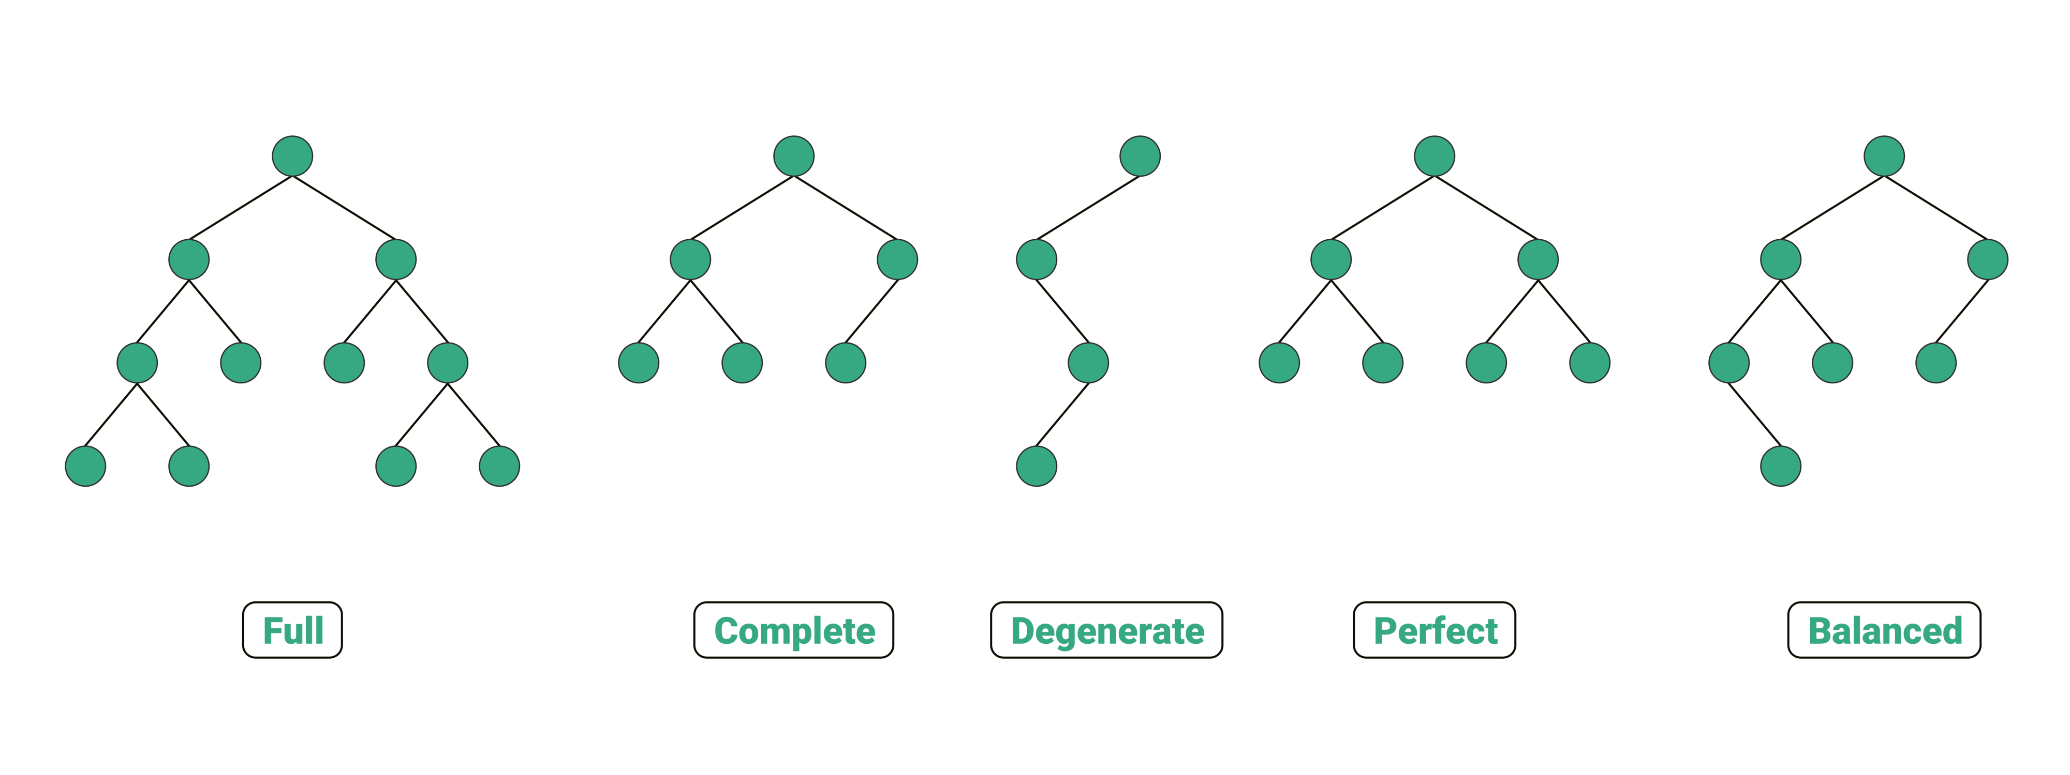
A1:
Balanced binary tree :
a binary tree in which the left and right subtrees of every node differ in height by no more than 1.
Degenerate binary tree : A degenerate binary tree is a binary tree in which each node has 1 child.

Slide 4
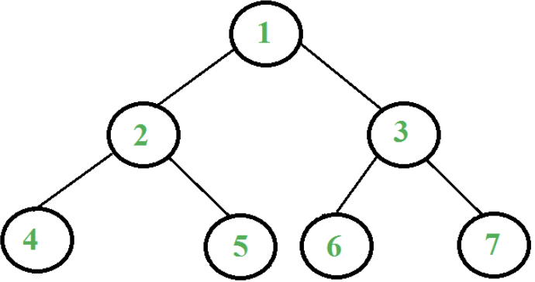
Q2:
Design a non-recursive method to traverse a binary tree in postorder.

Slide 5
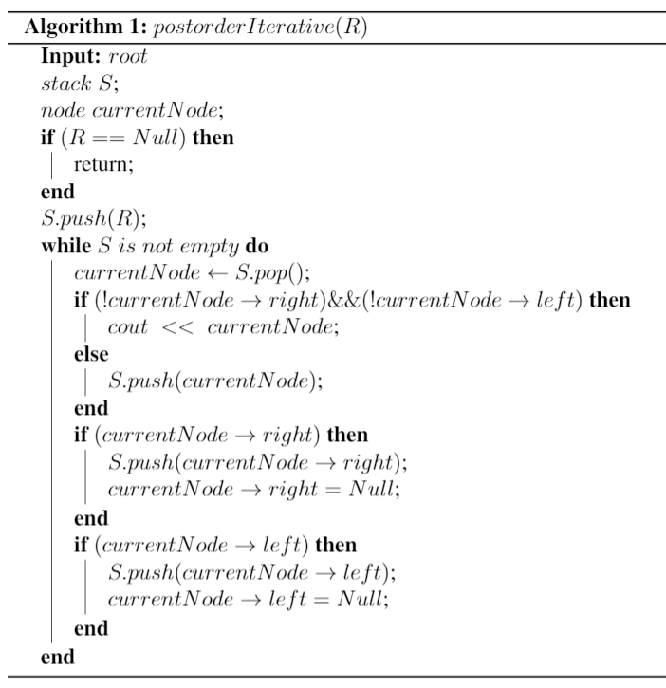
A2:

Slide 6
Q3:
Please construct a max-heap tree in both bottom-up and top-down method from the following array A, and explain how you do it and time complexity.
A[9] = { 2, 5, 1, 8, 9, 3, 6, 4, 7 }

Slide 7

A3: [Top-down]
Insert item $×n$
➔ worst case: O(n*log n)
➔ avg. case: O(n) [supplement]
9
8
6
7
5
1
3
2
4

Slide 8
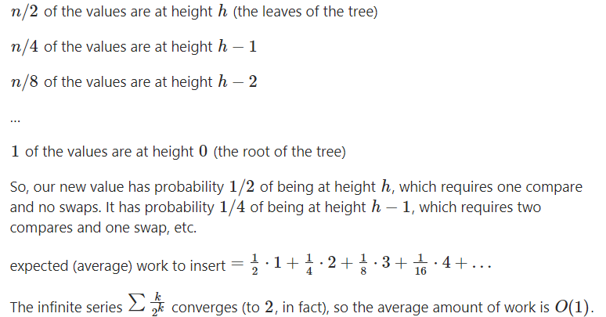
Insert - Avg. case : O(1)[supplement]

Slide 9
Insert - worst case : O(log n) [supplement]
How to optimize heap insertion of the worst case? hint: O(log (log n))

Slide 10
A3: [Bottom-up]
O(n)
9
8
6
7
5
3
1
4
2

Slide 11
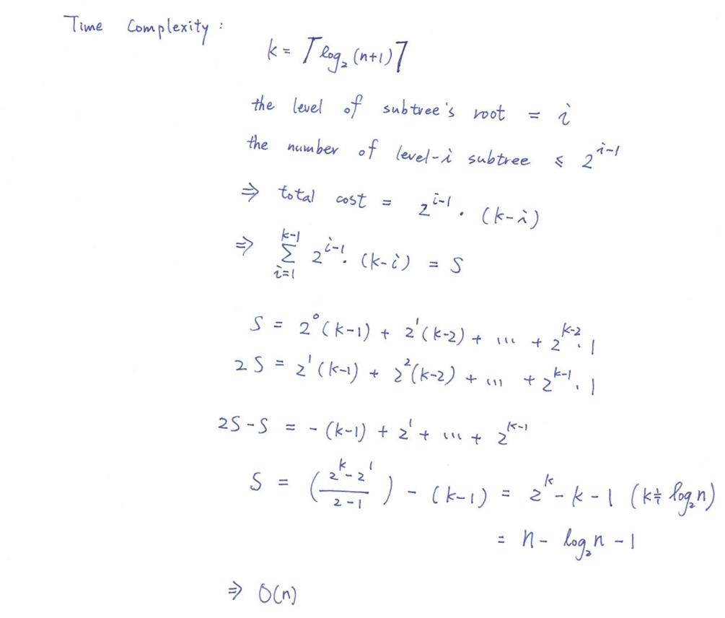
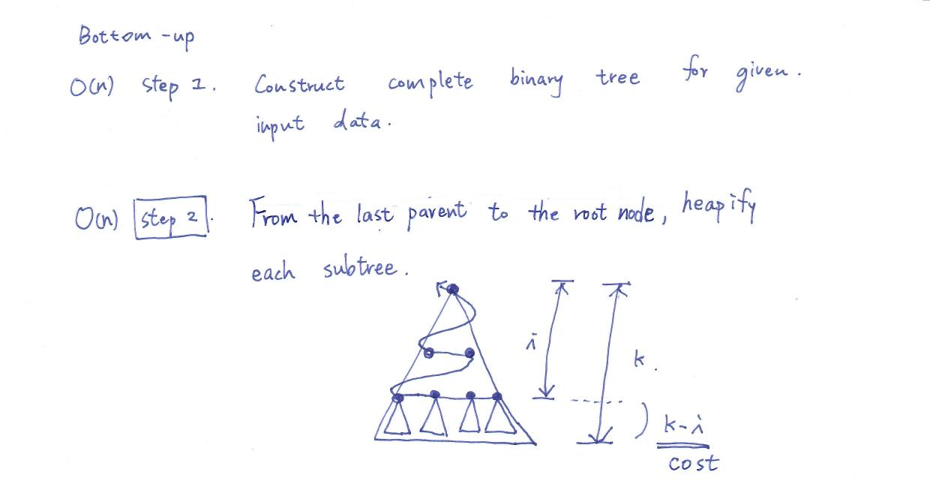
A3: [Bottom-up][supplement]

Slide 12
Q4:
Please re-construct all possible binary trees based on each following condition.
Inorder traversal sequence : 1 2 3
Preorder traversal sequence is equal to postorder traversal sequence
Postorder traversal sequence is equal to inorder traversal sequence

Slide 13
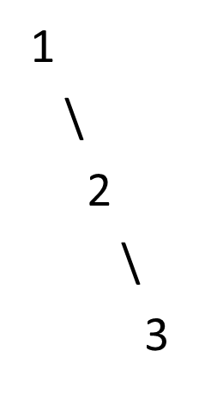
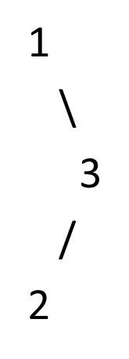
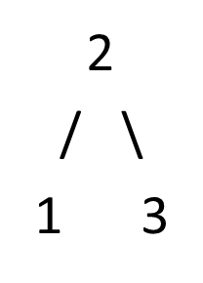
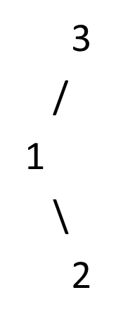
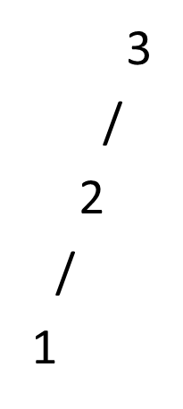
A4:
Empty and root only
Empty, root only and left skewed binary tree

Slide 14
Q5:
Answer True or Fales to the following questions and explain your answers.
A binary tree re-constructed, based on a given postorder traversal sequence and an inorder traversal sequence, is unique.
A binary tree re-constructed, based on a given postorder traversal sequence and a preorder traversal sequence, is unique.

Slide 15
A5:
D
True
Postorder : LRD
Inorder : LDR
We can always find the root node (i.e. D) from postorder sequence, then find the left and right subtrees (i.e. L & R) from inorder sequence.
→ unique
False
E.g.
Preorder : ABC
Postorder : CBA
L
R
A
A
A
A
B
B
B
B
C
C
C
C

Slide 16

Q6:
Prove that the node of index k in complete binary tree is at the height equals ⌊log₂k⌋+1 (The height of the root is 1.) ($k≥1$)

Slide 17





A6:
level
1
1
2
3
$$2^{h−1}−1<k$$
$${⇒2}^{h−1}≤k$$
….
….
$$⇒h−1≤\log{k}$$
$$⇒h=\text{⌊}\text{log}\text{2}\text{k}\text{⌋}{+1}$$
$2^{h−1}−1$
…
…
…
…
h-1
k
h

Slide 18
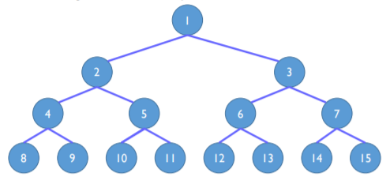
Q7:
Prove that a full binary tree of depth k has 2^{k}-1 nodes

Slide 19

A7:
$$2^{0}+2^{1}+…+2^{k−1}=2^{k}−1$$

Slide 20
Q8:
Can you apply Max/Min heap for sorting algorithm? If so, explain how to do it.

Slide 21
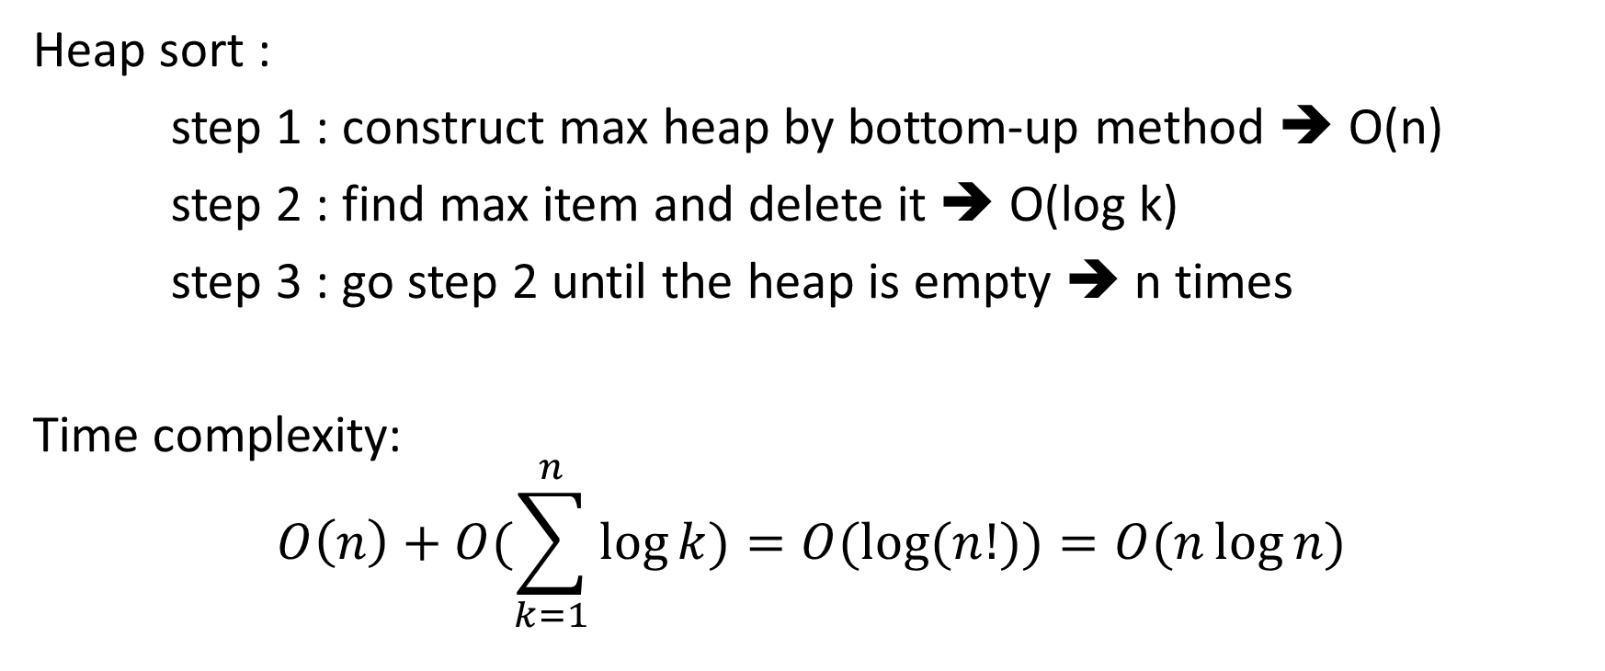
A8:
Heap sort :
step 1 : construct max heap by bottom-up method ➔ O(n)
step 2 : find max item and delete it ➔ O(log k)
step 3 : go step 2 until the heap is empty ➔ n times
Time complexity:
$$O\left(n\right)+O(\sum_{k=1}^{n}{\log{k}})=O(\log{(n!))=O(n\log{n)}}$$

Slide 22
The disadvantages of heap sort
What are the disadvantages of heap sort?
(Hint: spatial locality, unnecessary comparisons and exchange)
link

Slide 23
Q9:
If we use an array to represent a binary tree of n nodes, the indices of nodes can start from 0 to n-1. If the index of a father node is “p”, what are the indices of its left son and right son?

Slide 24
A9:
0
2p+1, 2p+2
1
2
….
p
…
…
…
2p+1
2p+2

Slide 25
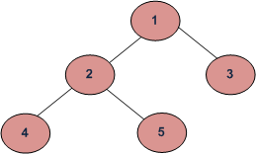
Q10:
Please write a program to calculate the size of a binary tree. The size of a tree is the number of elements present in the tree. For example, the size of the tree below is 5.

Slide 26
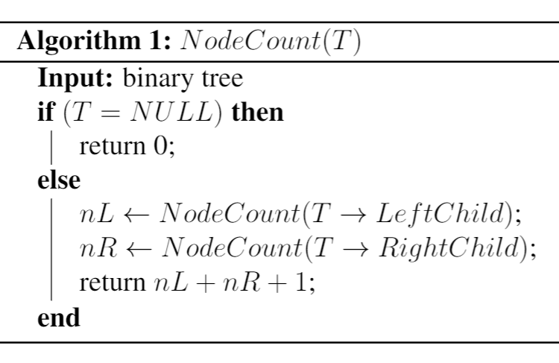
A10:

Slide 27
Q11:
Please write a program to count the number of leaf nodes in a binary tree. You must consider two cases: the binary tree is implemented by an array and by a linked list.

Slide 28
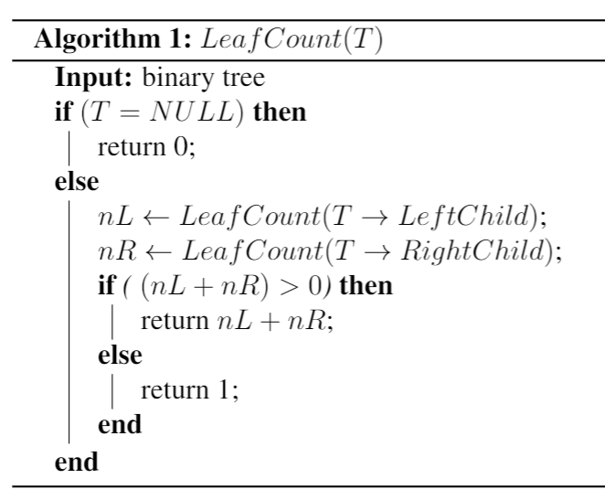
A11:

